Slide 1
A CONCISE INTRODUCTION TO INTELLIGENT AGENTS
Agentic AI
Autonomous AI systems that reason, plan and act
AGENTIC AI
1 / 15

Slide 2


What is Agentic AI?
CONCEPT
Goal Pursuit
AI that can pursue goals with limited human intervention.
Core Capabilities
Combines reasoning, planning, tool use, memory, and action.
Beyond Chatbots
Unlike simple chatbots, agents decide what steps to take next.
AGENTIC AI
2 / 15

Slide 3

AI Agent vs. Agentic AI
COMPARISON
AI Agent
Agentic AI
A software entity that performs a task using inputs and rules or pre-trained models.
A broader approach where agents operate autonomously toward goals, coordinating multiple agents and tools.
AGENTIC AI
3 / 15

Slide 4
Traditional AI vs. Agentic AI
COMPARISON
Traditional AI
Agentic AI
Responds to specific inputs
Breaks goals into sub-tasks
Follows predefined workflows
Dynamically chooses actions
Predict and respond model
Reason, plan and act loop
AGENTIC AI
4 / 15

Slide 5
Architecture of Agentic AI
ARCHITECTURE
STEP 1
STEP 2
STEP 3
STEP 4
STEP 5
User Goal
Planning
Reasoning
Tool Selection
Action
Feedback is used to revise the plan through observation and memory until the goal is achieved.
AGENTIC AI
5 / 15

Slide 6
Key Components
COMPONENTS
Perception
Reasoning
Planning
Understands user requests and environment.
Analyzes information and selects suitable actions.
Decomposes complex goals into smaller tasks.
Memory
Tools
Stores useful context and past interactions.
APIs, databases, browsers, and code interpreters.
Integrated Agent Stack
AGENTIC AI
6 / 15

Slide 7

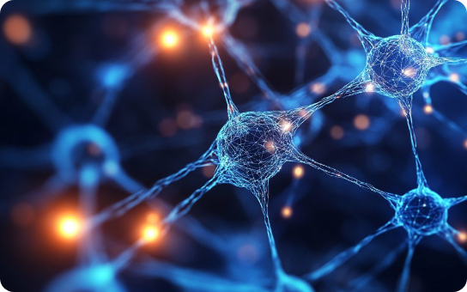
How Agentic AI Works
WORKFLOW
01
Receive a goal and understand constraints
02
Create plan and select appropriate tools
03
Execute actions and observe results
04
Evaluate, revise, and deliver final result
AGENTIC AI
7 / 15

Slide 8
Types of AI Agents
TYPES
Reactive Agents
Goal-Based Agents
Utility-Based Agents
Respond directly to current inputs.
Choose actions to achieve a specific goal.
Select actions based on expected usefulness.
Learning Agents
Multi-Agent Systems
Improve continuously from experience.
Multiple agents collaborate and coordinate.
Taxonomy of Intelligence
AGENTIC AI
8 / 15

Slide 9
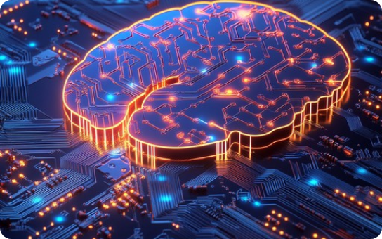
Technologies Used
TECHNOLOGY
LLMs
RAG
Core reasoning engines
Retrieval augmentation
APIs
Vector DBs
Function calling and tools
Semantic embeddings
AGENTIC AI
9 / 15

Slide 10
Real-World Applications
APPLICATIONS
Customer Support
Software Engineering
Research & Gathering
Automated multi-step service resolution.
Autonomous coding and debugging assistance.
Deep information synthesis and analysis.
Cybersecurity
Business Automation
Healthcare & Edu
Continuous threat monitoring and response.
Streamlining complex multi-system workflows.
Personalized learning and care assistance.
AGENTIC AI
10 / 15

Slide 11

Advantages
BENEFITS
Reduces Manual Work
Multi-Step Execution
Eliminates repetitive tasks through smart automation.
Handles complex workflows seamlessly from start to finish.
Dynamic Adaptation
Tool Integration
Adapts plans dynamically based on new real-time info.
Integrates multiple external tools and diverse data sources.
AGENTIC AI
11 / 15

Slide 12
Challenges & Limitations
CHALLENGES
Hallucinations
Security Risks
Unpredictability
Incorrect reasoning or factual errors.
Privacy and unauthorized access risks.
Complex workflows can behave unexpectedly.
Tool Failures
High Cost
Oversight Needed
API timeouts or breakdowns affect results.
High computational and operational expenses.
Requires strict monitoring and permissions.
AGENTIC AI
12 / 15

Slide 13

Future of Agentic AI
FUTURE
Autonomous Assistants
More capable digital coworkers for daily tasks.
Multi-Agent Collaboration
Teams of specialized agents solving enterprise projects.
Robust Governance
Stronger safety, memory, and human-in-the-loop controls.
AGENTIC AI
13 / 15

Slide 14
Conclusion
SUMMARY
Goal Completion
Agentic AI moves AI from answering questions toward actively completing complex goals.
The Core Loop
Perceive → reason → plan → act → observe → improve continuously.
Responsible Deployment
Requires security, robust evaluation, monitoring, and human oversight.
AGENTIC AI
14 / 15

Slide 15
Thank You
Questions & Discussion
AGENTIC AI
15 / 15

Slide 16




Image Sources
https://media.istockphoto.com/id/1206796363/photo/ai-machine-learning-hands-of-robot-and-human-touching-on-big-data-network-connection.jpg?s=612x612&w=0&k=20&c=xIX5Bz7h50B83cCZG_gXkyZSOu-mG93DtOcNK7RNEAo=
Source: www.istockphoto.com
https://b2287888.assetcdn.net/2.0/2287888/wp-content/uploads/2025/04/neural-network-connections-illustration.jpg?lossy=1&strip=1&webp=1
Source: www.presentationgo.com
https://images.stockcake.com/public/2/0/9/20929d4f-d3af-46bd-a2ea-3a176c833ca4_large/illuminated-neural-network-stockcake.jpg
Source: stockcake.com
https://roticsymposium.com/wp-content/uploads/2025/02/futuristic-robotic-arm.png
Source: roticsymposium.com

